Slide 1
Double Ended Queue
(Deque)

Slide 2
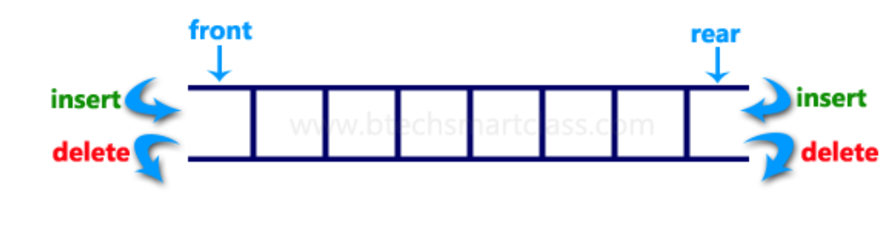
Double Ended Queue
Insertion and Deletion happens at both ends i.e. at Rear end and Front end.

Slide 3
Main Four Operations.
1. Insert at Rear end-----enqueue_At_Rear()
Insert at Front end------ enqueue_At_Front()
Delete at Front end-----dequeue_At_Front()
4. Delete at Rear end-------dequeue_At_Rear()

Slide 4
Types of Deque
Double Ended Queue can be represented in TWO ways, those are as follows...
Input Restricted Double Ended Queue
Output Restricted Double Ended Queue

Slide 5
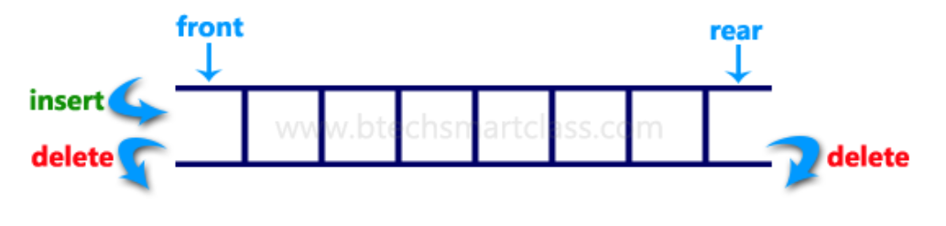
Input Restricted Double Ended Queue
In input restricted double-ended queue, the insertion operation is performed at only one end and deletion operation is performed at both the ends.

Slide 6
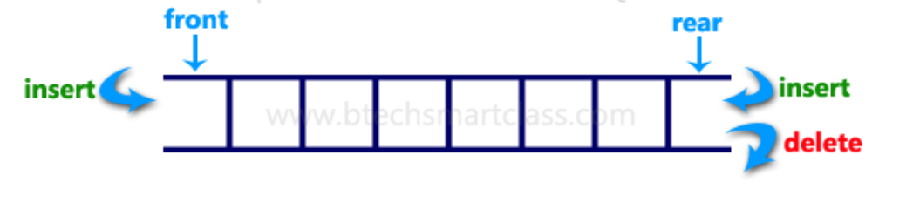
Output Restricted Double Ended Queue
In output restricted double ended queue, the deletion operation is performed at only one end and insertion operation is performed at both the ends.

Slide 7
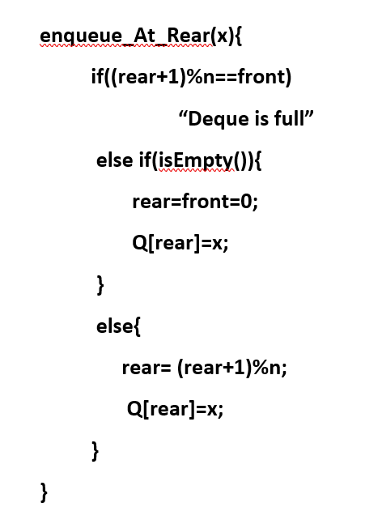
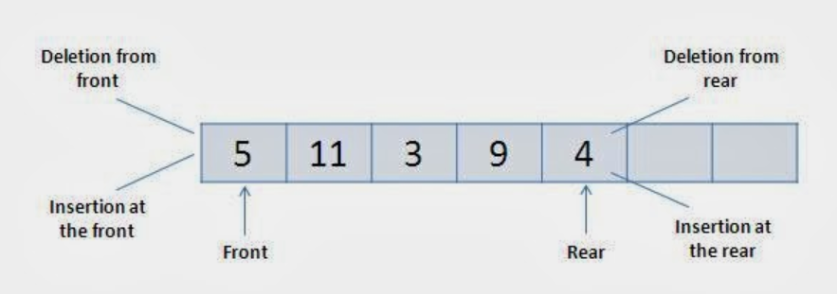
Insert at Rear end-----enqueue_At_Rear(x)
Increment the rear--- rear=(rear+1)%n

Slide 8
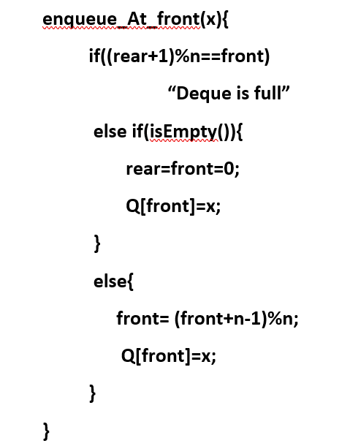
Insert at front end-----enqueue_At_front(x)
Decrement the front--- front=(front+n-1)%n
Example i=0, the previous index will be (0+6)%7=6
i=2, the previous index will be (i+n-1)%n=(2+6)%7=1

Slide 9
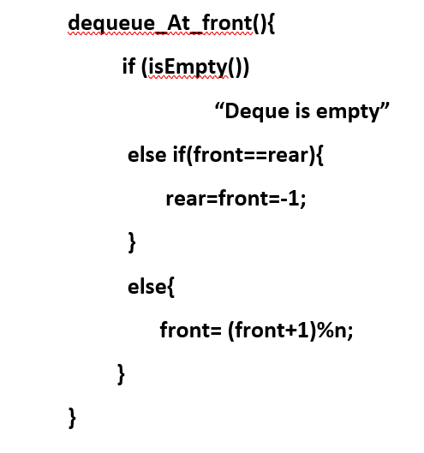
Delete at front end-----dequeue_At_front()
Increment the front--- front=(front+1)%n

Slide 10
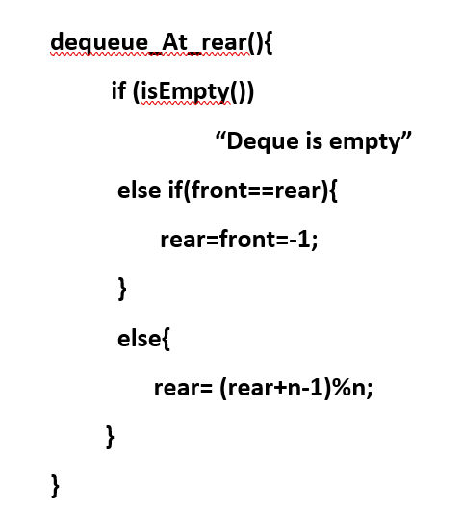
Delete at rear end-----dequeue_At_rear()
decrement the rear--- rear=(rear+n-1)%n

Slide 11
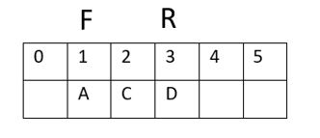
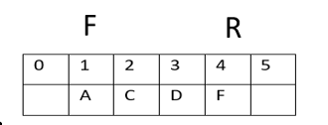
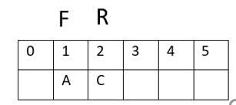
Consider a deque with size 6 and front pointing to index 1 and rear pointing to index 3. Perform the following operations.
enqueue_At_Rear(F)
dequeue_At_Rear(), dequeue_At_Rear()

Slide 12
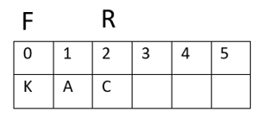
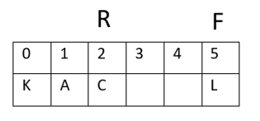
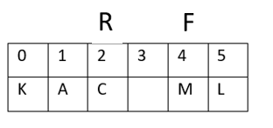
enqueue_At_Front(K)
enqueue_At_Front(L)
enqueue_At_Front(M)

Slide 13
Palindrome Checker
An interesting problem that can be easily solved using the deque data structure is the classic palindrome problem.
A palindrome is a string that reads the same forward and backward, for example, radar, toot, and madam. We would like to construct an algorithm to input a string of characters and check whether it is a palindrome.

Slide 14
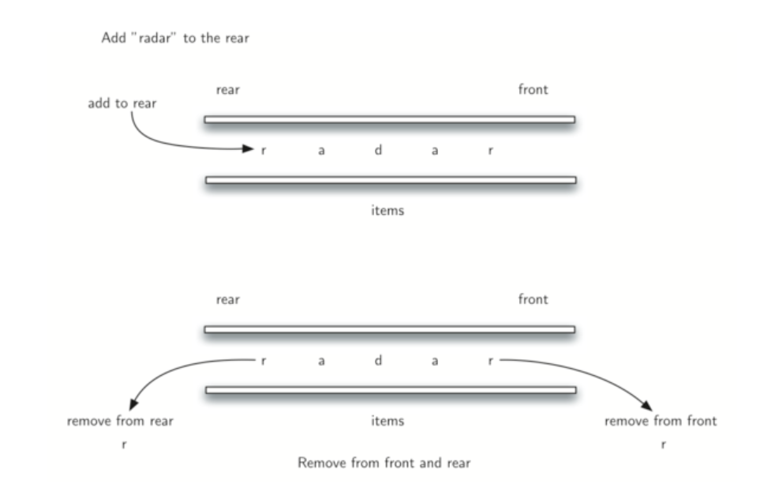

Slide 15
Thank You

